Slide 1


University Management Database
A CFG Project by Kirsty Idoko
Notes:
Total presentation time: 3-5 min
Why I chose this database:
I am a uni student – got me curious about how MySQL could be used in uni setting
Decided on management system – track students, staff, courses, etc.

Slide 2
About the database
Keeps a record of students, teaching staff (instructors), faculties, degree programmes (courses) and modules
Students: add new entries, calculate year of study and academic standing
Contains two views:
student_courses: Shows students, course, faculty
mod_ins_fac: Show modules, instructors, faculty
All data used here is completely fictional

Slide 3
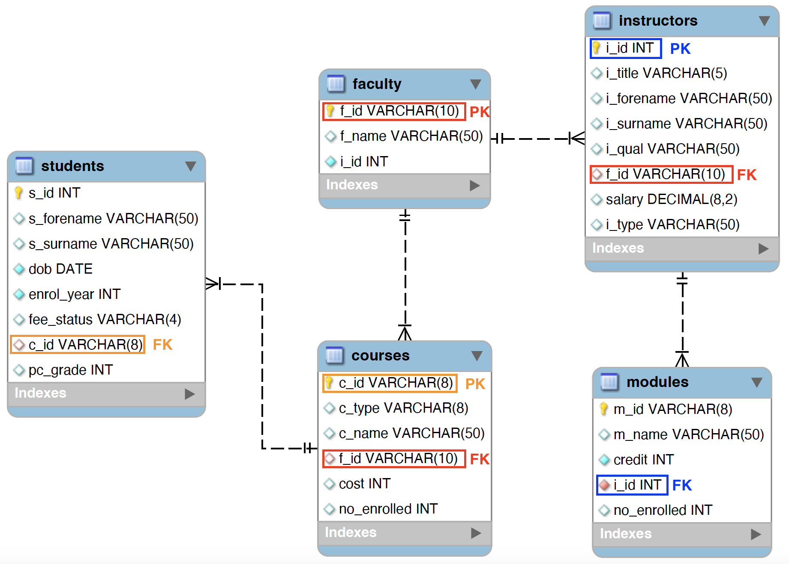
The data
Fact table: faculty
Dimension tables: students, courses, instructors, modules
All connections are one-to-many

Slide 4
Let’s see the data in action!

